Slide 1
EV Remote Internship Project Report
Created by
THATHIREDDY HEMANTH,
Diploma & B.Tech (Final Year) Siddharth inst of Engg and Tech.
Puttur, AP.
Project name:
Ather Energy 450
Case Studies: FTP-75/MENDC/WLTP Drive Cycle

Slide 2
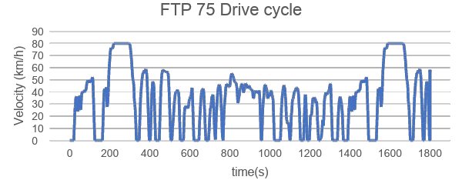
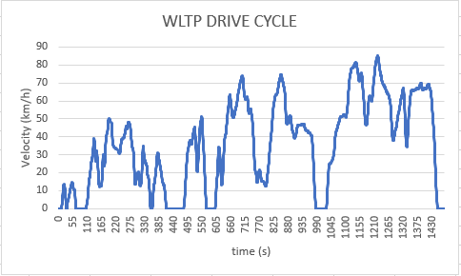
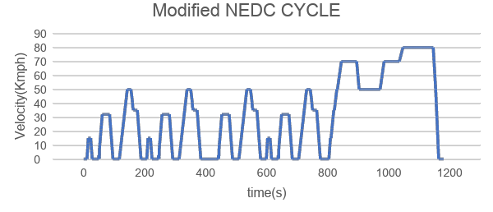
Drive Cycles
FTP-75 Drive Cycle
WLTP Drive Cycle
NEDC Drive Cycle

Slide 3
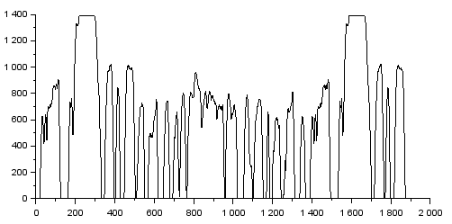
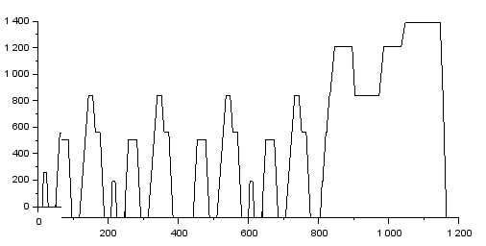
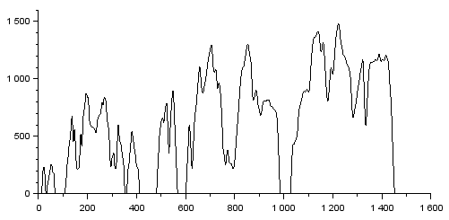
Wheel Speed for different Drive Cycles
FTP-75 Drive Cycle
MNEDC Drive Cycle
WLTP Drive Cycle
Maximum Speed = 1392.431 | Maximum Speed =1392.431 | Maximum Speed = 1482.939
Average Maximum Speed = 1422.6rpm

Slide 4
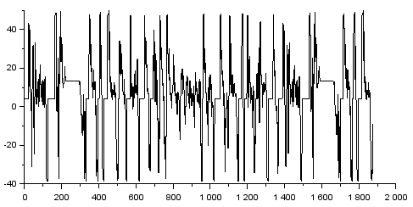
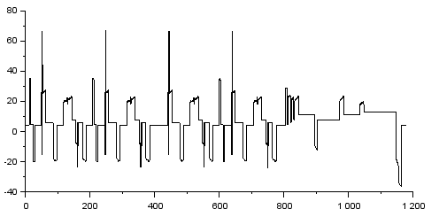
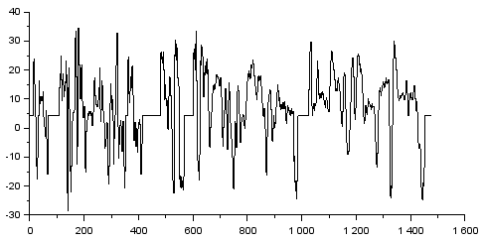
Wheel Torque for different Drive Cycles
FTP-75 Drive Cycle
MNEDC Drive Cycle
WLTP Drive Cycle
MaximumTorque = 49.727 | MaximumTorque = 66.040 | Maximum Torque = 34.606
Average Maximum Torque = 50.124 Nm

Slide 5
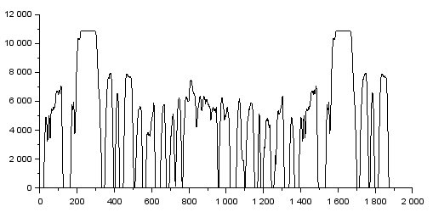
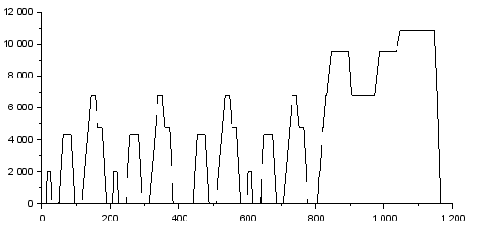
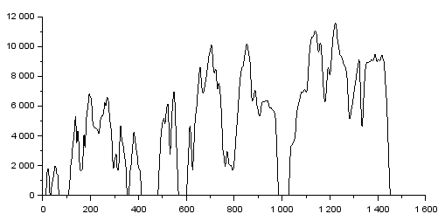
Motor Speed for different Drive Cycles
FTP-75 Drive Cycle
MNEDC Drive Cycle
WLTP Drive Cycle
Maximum Speed = 10860.967 | Maximum Speed = 10860.967 | Maximum Speed = 11566.93
Average Maximum Speed = 11096.288 rpm

Slide 6
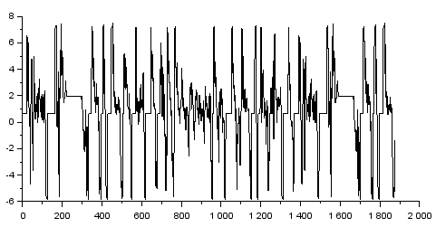
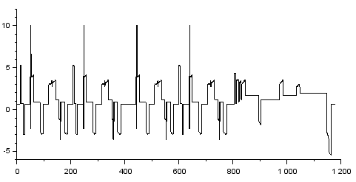
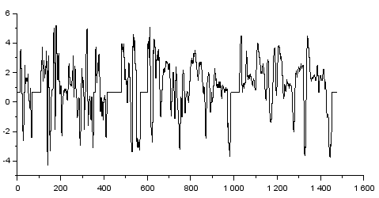
Motor Torque for different Drive Cycles
FTP-75 Drive Cycle
MNEDC Drive Cycle
WLTP Drive Cycle
Nominal Torque = 7.5 | Nominal Torque = 10.050 | Nominal Torque = 5.219
Average Nominal Torque = 7.589 Nm

Slide 7
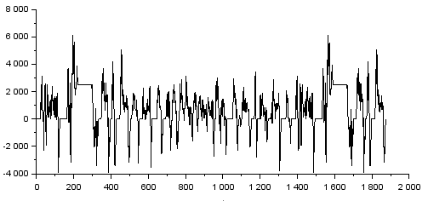
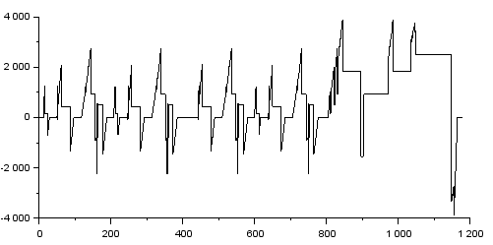
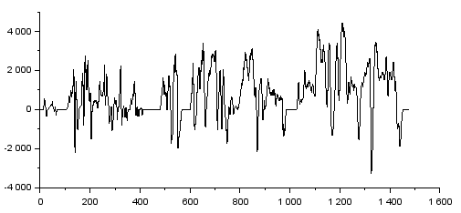
Motor Power for different Drive Cycles
FTP-75 Drive Cycle
MNEDC Drive Cycle
WLTP Drive Cycle
Nominal Power = 61214.562 | Nominal Power = 3872.295 | Nominal Power = 4441.871
Average Nominal Power =23176.242 W

Slide 8
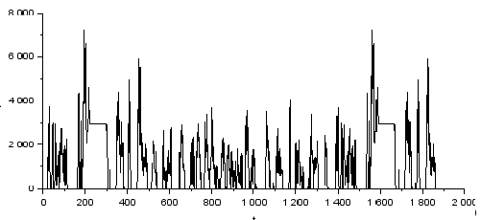
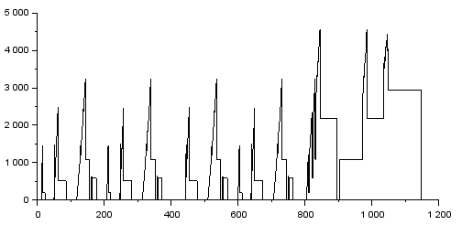
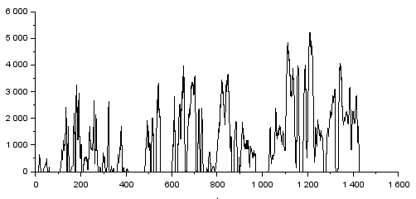
Battery Power for different Drive Cycles
FTP-75 Drive Cycle
MNEDC Drive Cycle
WLTP Drive Cycle
Nominal Power = 7205.368 | Nominal Power = 4555.641 | Nominal Power = 5225.730
Average Nominal Power = 5662.246W

Slide 9
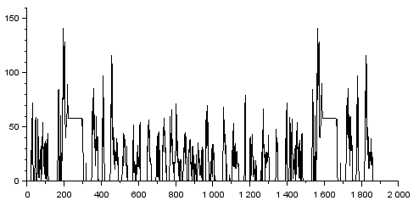
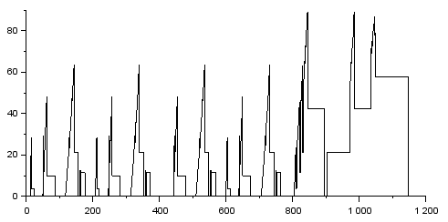
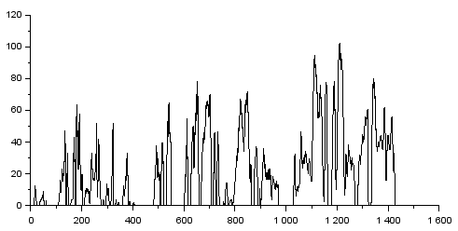
Battery Current for different Drive Cycles
FTP-75 Drive Cycle
MNEDC Drive Cycle
WLTP Drive Cycle
Nominal Current = 141.005 | Nominal Current = 89.151 | Nominal Current = 102.264
Average Nominal Current = 110.806 A

Slide 10

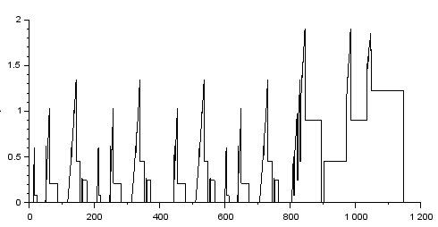
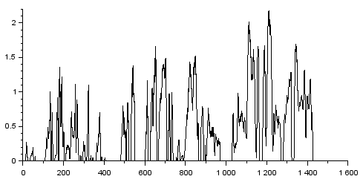
Battery Dischaarge C-Rate for different Drive Cycles
FTP-75 Drive Cycle
MNEDC Drive Cycle
WLTP Drive Cycle
Nominal Dischaarge C-Rate = 3 | Nominal Dischaarge C-Rate = 1.896 | NominalDischaarge C-Rate = 2.175
Average Nominal Dischaarge C-Rate =2.357 C

Slide 11
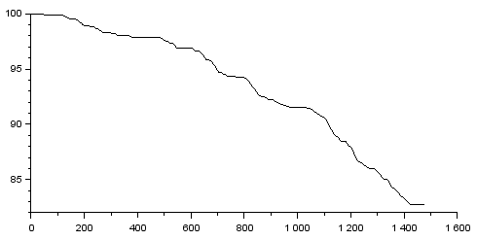
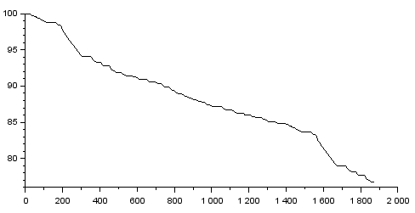
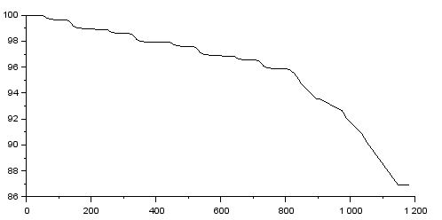
SOC for different Drive Cycles
FTP-75 Drive Cycle
MNEDC Drive Cycle
WLTP Drive Cycle
State of Charge = 76.74 | State of Charge = 86.93 | State of Charge = 82.693
Average Nominal Torque = 82.121 %

Slide 12
Range for different Drive Cycles
FTP 75 | MNEDC | WLTP
75.2km | 78.7 km | 84.8km

Slide 13
Thank you
Email-id : hemanthandprakash@gmail.com
Mobile no.: 7093625879

